Slide 1
SBOM Sprint #1
Thomas Eby, Pranav Gonepalli, Evan Hellersund, Manel Leong,
Camron Rule, Skyler Walker, Duohan Xu, Rachel Zheng
College of William & Mary
CSCI 435: Software Engineering
September 25, 2024

Slide 2
Sprint Goal
Perform independent research to further understand:
What SBOMs are,
How developers use them in the real world,
What SBOM information would be useful in a visualization tool.
Identify what capabilities our tool should support

Slide 3
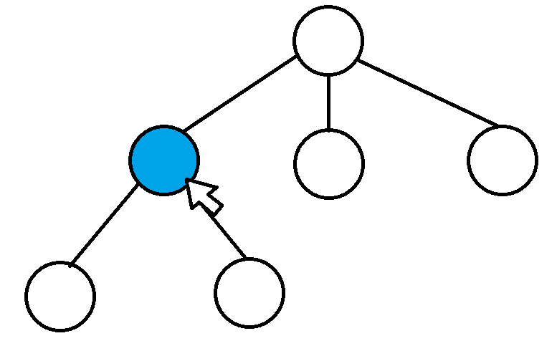
Capabilities
Django website with interactive interface
HTML, CSS, JavaScript
Tree-style traversal of SBOM
Short 1-page PDF summary of important information
Ability to specify the version and file type of SBOM before uploading it
Cyclone DX, SPDX, SWID tags for versions
Json and xml file types

Slide 4
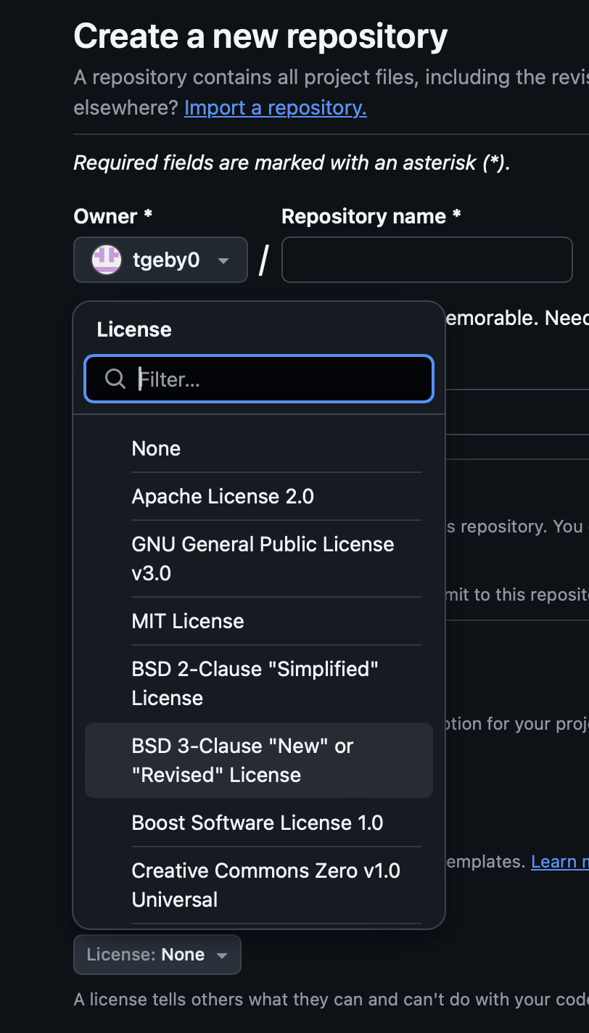
Capabilities Continued
Ability to filter SBOM data fields
A way to query and display the restrictions placed on the project based on the licenses
Support for the software licenses available to associate with a GitHub repo
A way to query a database for security vulnerabilities

Slide 5
Tools and Dependencies
Git, Visual Studio Code
HTML, CSS, JavaScript, D3.js
Django Rest Framework (DRF): To serve data as a JSON API.
Django-MPTT or Django-Treebeard: For managing hierarchical models.

Slide 6
Next Sprint Backlog
Issue tracker
Artifacts - UML diagrams, etc.
Plan the layout of our visualization tree
Research the requirements placed on the different software licenses
Identify databases to use for identifying security vulnerabilities

Slide 7
Lessons
Working asynchronously on shared documents resulted in slow response time.
We should try to meet in person or on Zoom at least once during a sprint to share what we have come up with.
Meeting times couldn’t be made by all members of the team.
We should try and work out regular meeting times that can be made by all team members.

Slide 8
Contribution
Camron Rule: Created slideshow outline
Thomas Eby: Created capability proposal outline
All: Contributed to slideshow and capability proposals by contributing new ideas or affirming/challenging the ideas of others

